Slide 1

Notes:
Module x: Title
Course xxxxy
Presentation: xx minutes
Lab: xx minutes
This module helps students to ….
After completing this module, students will be able to:
Objective #1.
Objective #2.
Objective #3.
Required materials
To teach this module, you need the Microsoft Office PowerPoint® file xxxxy_xx.ppt.
Important It is recommended that you use PowerPoint 2002 or a later version to display the slides for this course. If you use PowerPoint Viewer or an earlier version of PowerPoint, all the features of the slides might not be displayed correctly.
Preparation tasks
To prepare for this module:
Read all of the materials for this module.
Practice performing the demonstrations and the lab exercises.
Work through the Module Review and Takeaways section and determine how you will use this
section to reinforce student learning and promote knowledge transfer to on-the-job performance.
If this is a KonaH product, use this section:
Make sure that students are aware that there are additional information and resources for the module on the Course Companion CD.
If this is a Forte product, use this section:
Make sure that students are aware that there are additional online resources for the module on the Course CD.

Slide 2
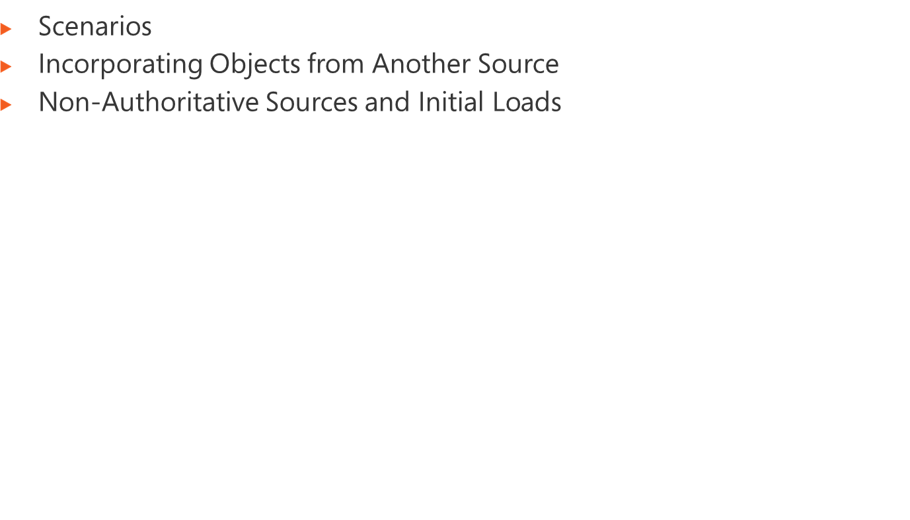
Notes:
Module x: Title
Course xxxxy

Slide 3
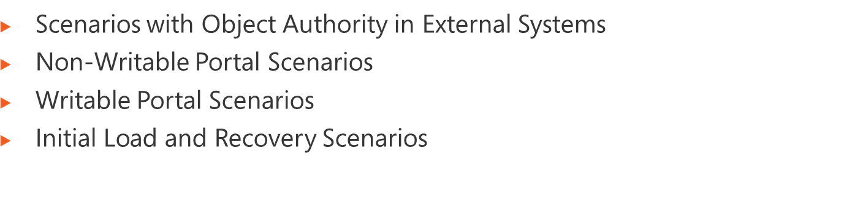
Notes:
Module x: Title
Course xxxxy
Detailed steps to add MA, import objects and export to portal (changes schemas, add MA, attribute flows, provision ILM 2, export, note provision to AD (and effect if they already exist in AD)
Relationship between ILM 2007 rules and the Portal Configuration components

Slide 4
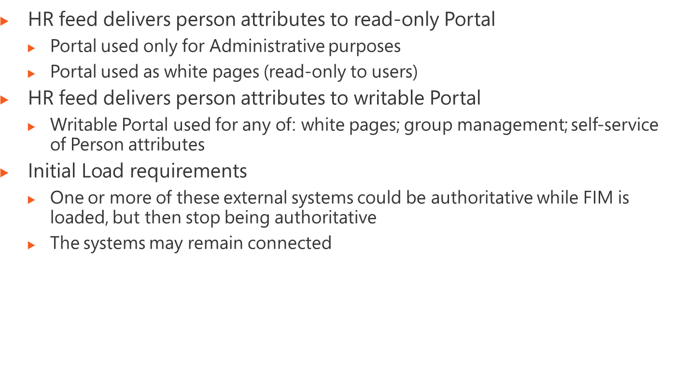
Notes:
Module x: Title
Course xxxxy
As above but add self-service (so portal authoritative for some attributes – note that we need code to achieve initial attribute load for future new objects)
As above but authority transfers (either it just was an initial load, or we have a subsequent change of policy) – from AD (unlikely that HR would no longer be authoritative)
Other authoritative sources like contractors and students; separate identities; multiple HR sources; AD for computer objects and (named) groups (dynamic possible?)
Sources that are not authoritative for objects:
New MA for existing data to join to existing metadirectory (and may staty joined or jst be a load)
Data discovery scenarios
Initial Load
Disaster recovery
Special considerations for discovery (initial load or DR): need for a plan, identifying authoritative sources, convergence, breadcrumbs, provisioning turned off except for ILM2 (therefore do that first), usefulness of backups [remember they are supposed to know ILM 2007)]

Slide 5
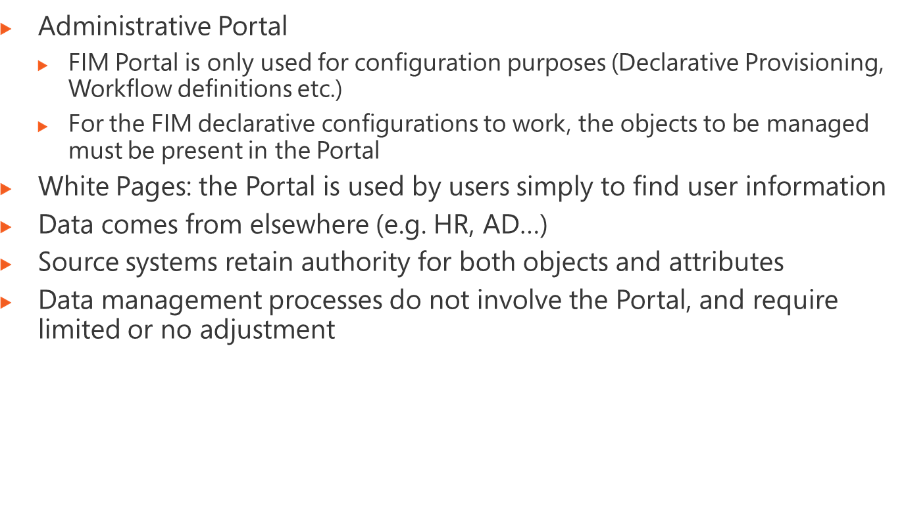
Notes:
Module x: Title
Course xxxxy

Slide 6
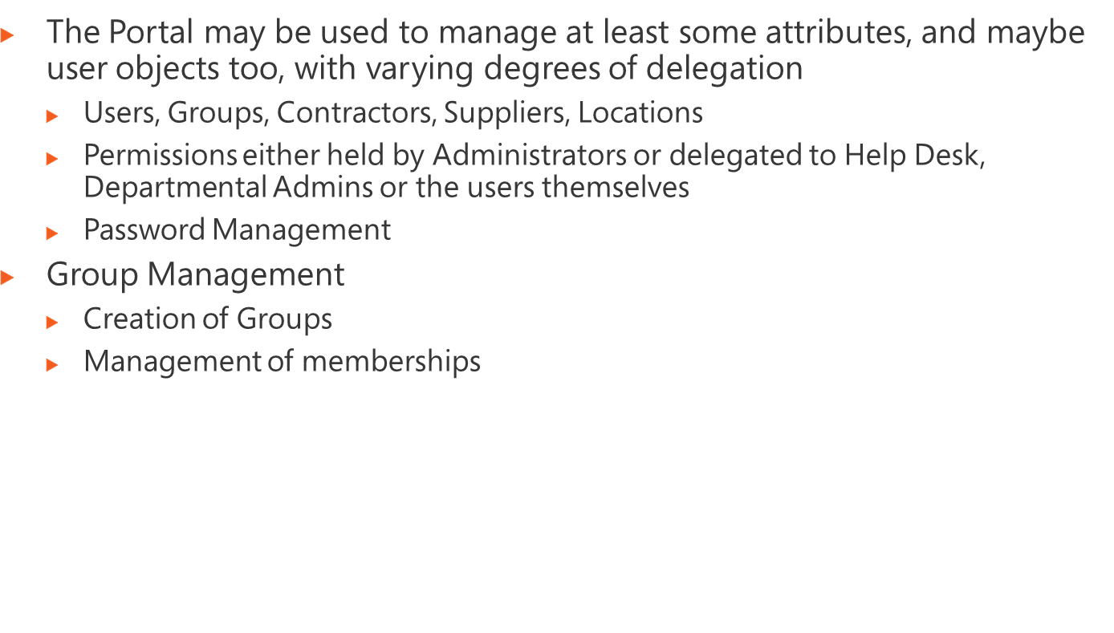
Notes:
Module x: Title
Course xxxxy

Slide 7
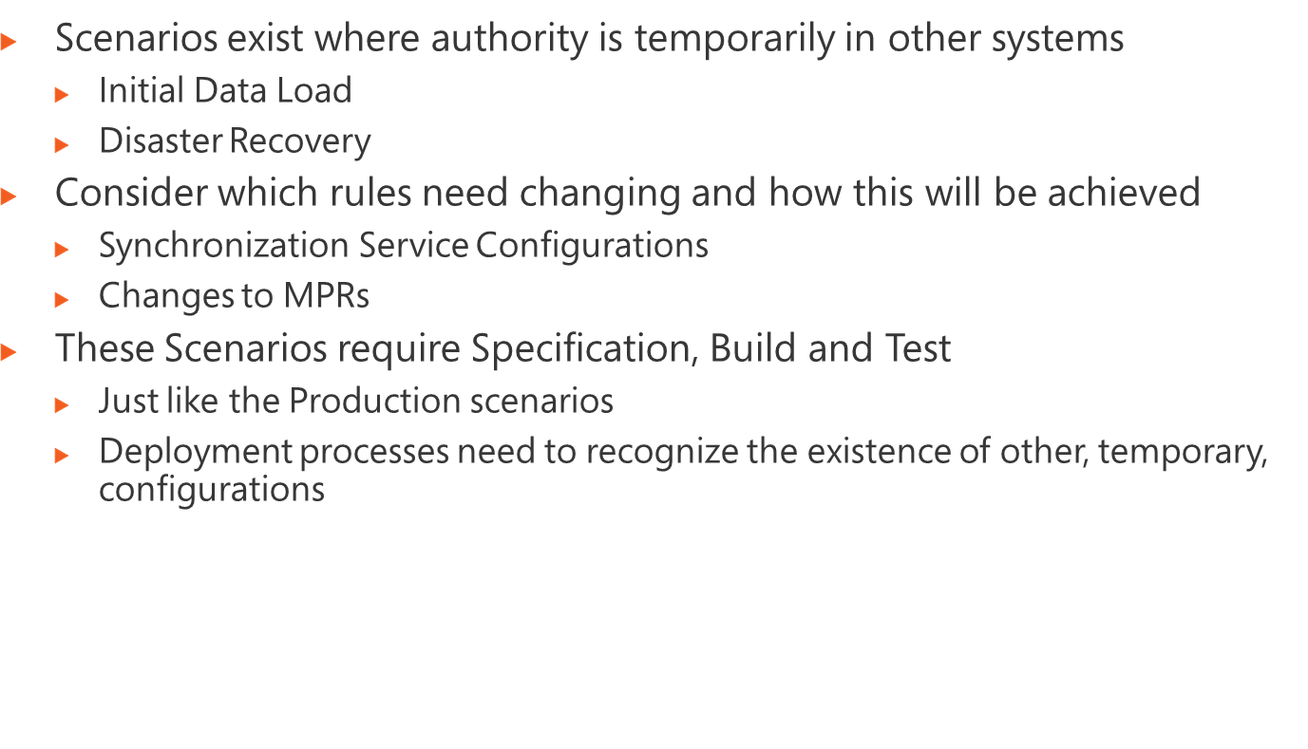
Notes:
Module x: Title
Course xxxxy

Slide 8

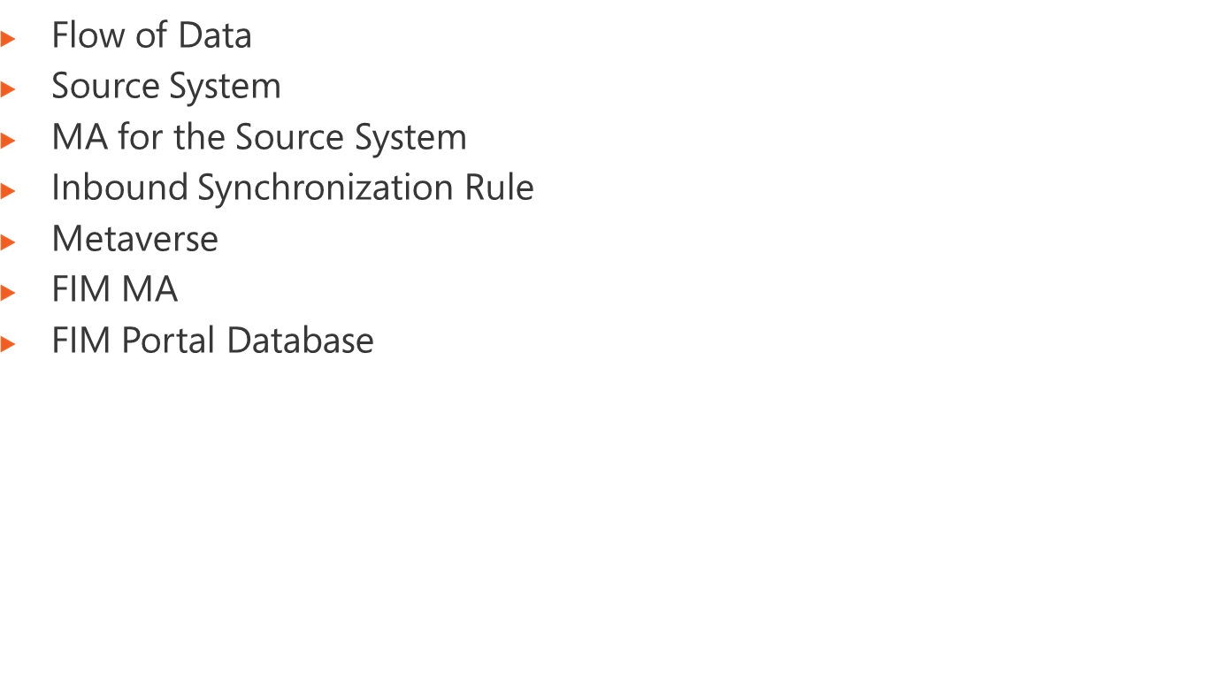
Notes:
Module x: Title
Course xxxxy
Detailed steps to add MA, import objects and export to portal (changes schemas, add MA, attribute flows, provision FIM, export, note provision to AD (and effect if they already exist in AD)
Relationship between ILM 2007 rules and the Portal Configuration components

Slide 9








3
Portal
Database
7
6
4
8
Active
Directory
5
10
9
HR Feed
1
2
Notes:
Module x: Title
Course xxxxy

Slide 10
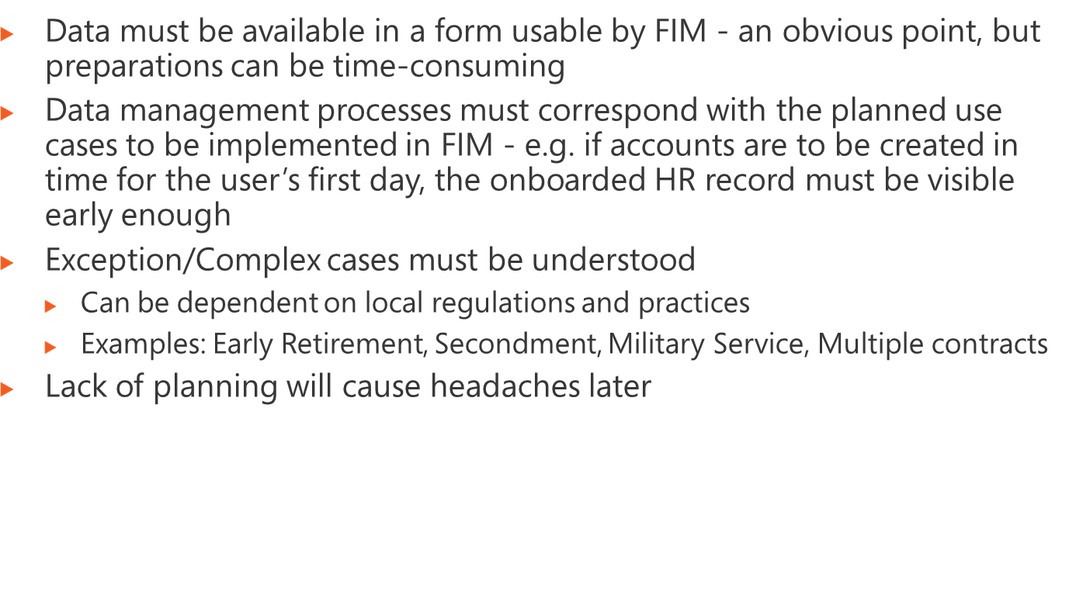
Notes:
Module x: Title
Course xxxxy

Slide 11
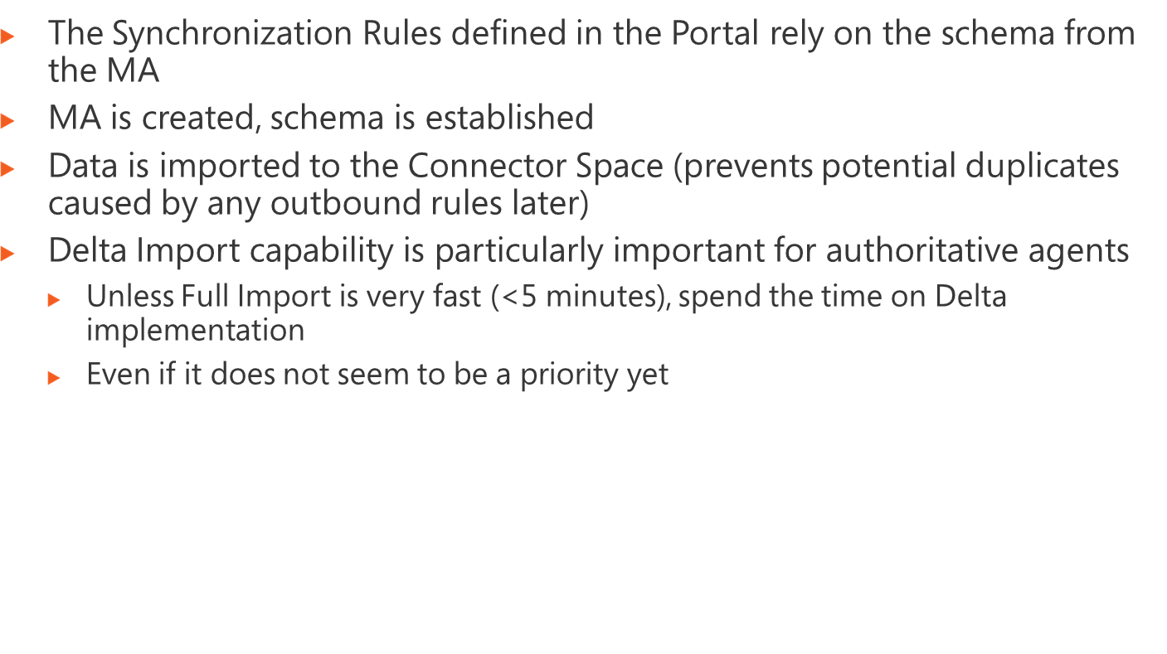
Notes:
Module x: Title
Course xxxxy
Use the questions on the slide to guide the debriefing after students have completed the lab exercises.

Slide 12
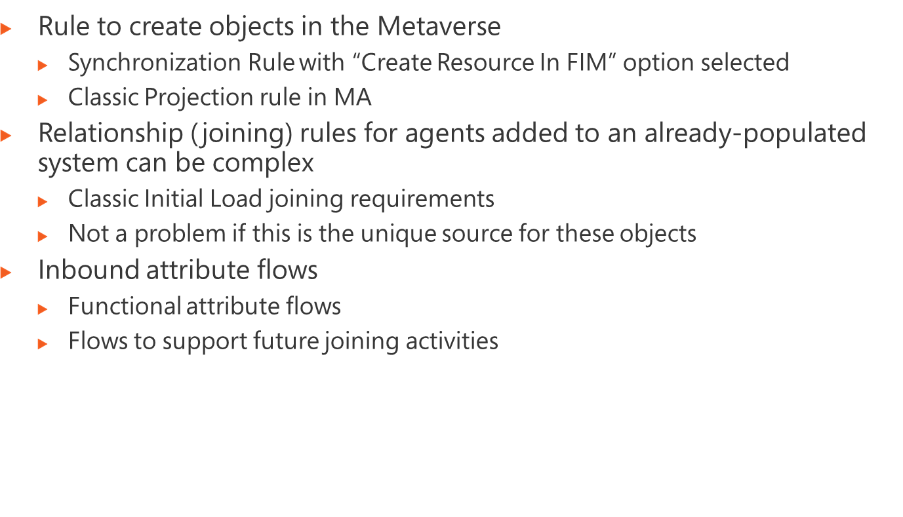
Notes:
Module x: Title
Course xxxxy
“Flows to support future joining activities”: because we have no join mappings, it is a good idea to create MV attributes which contain the transformed attributes so that other systems can join successfully. E.g. if a system uses CowlingJ rather than JamesC, create a metaverse attribute to contain the CowlingJ-type values (probably on the ILM agent, actually) but in any case while considering the Initial Load scenarios.

Slide 13
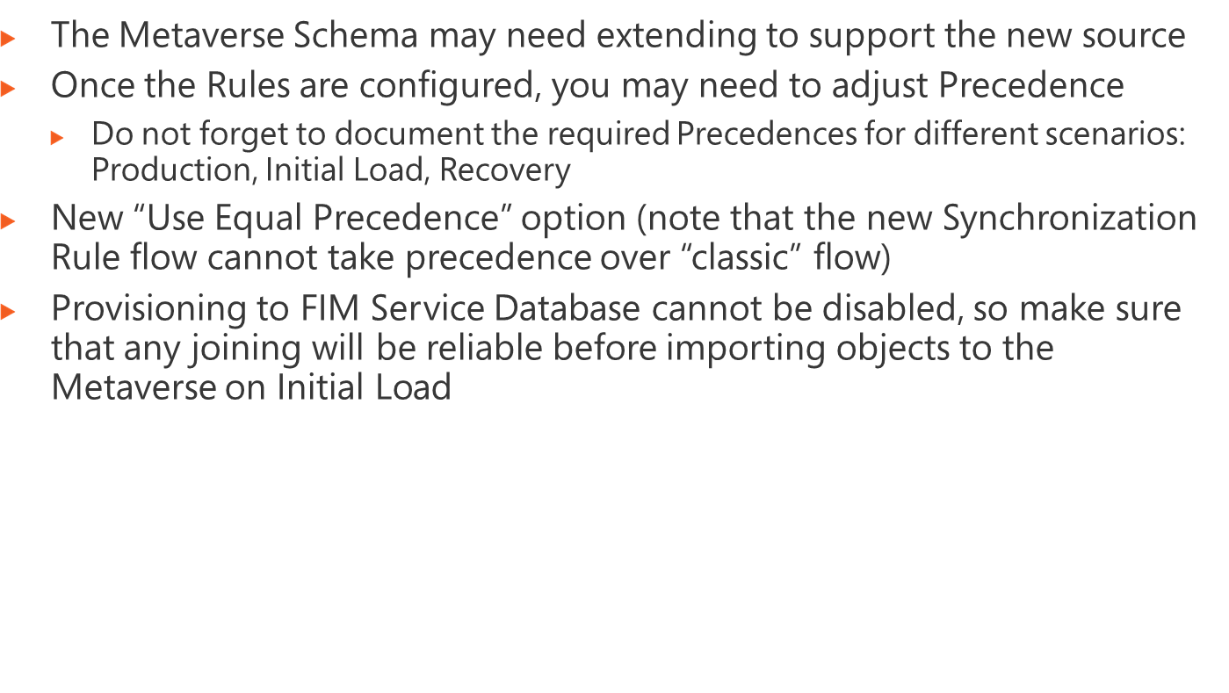
Notes:
Module x: Title
Course xxxxy
Use the questions on the slide to guide the debriefing after students have completed the lab exercises.

Slide 14
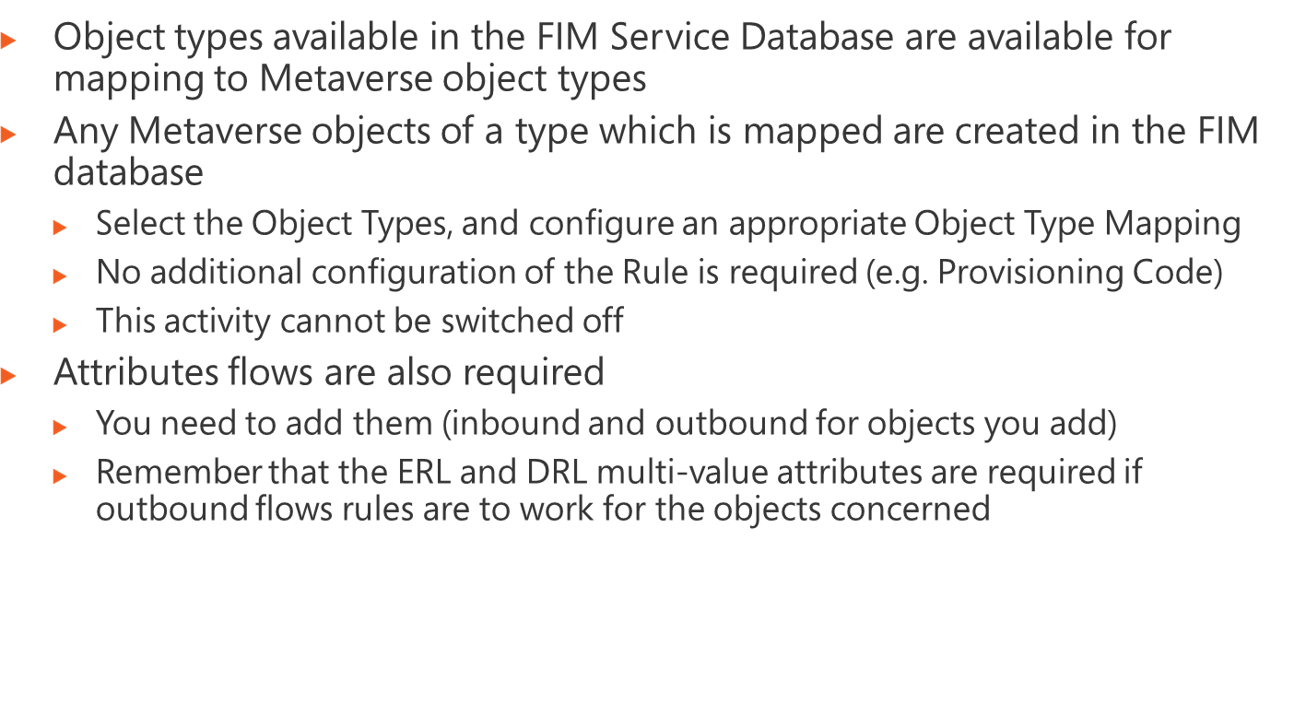
Notes:
Module x: Title
Course xxxxy
Use the questions on the slide to guide the debriefing after students have completed the lab exercises.

Slide 15
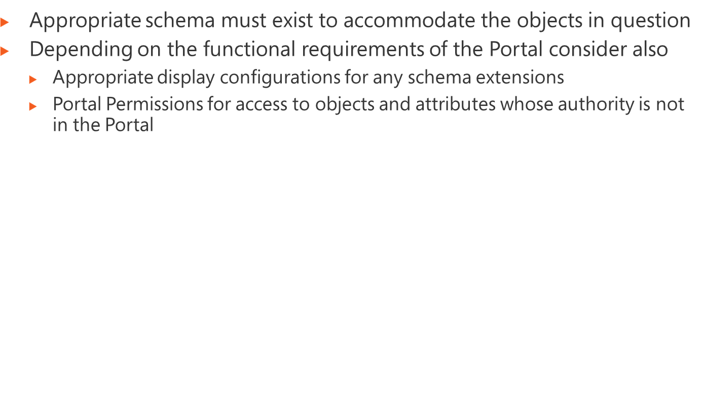
Notes:
Module x: Title
Course xxxxy
Use the questions on the slide to guide the debriefing after students have completed the lab exercises.

Slide 16
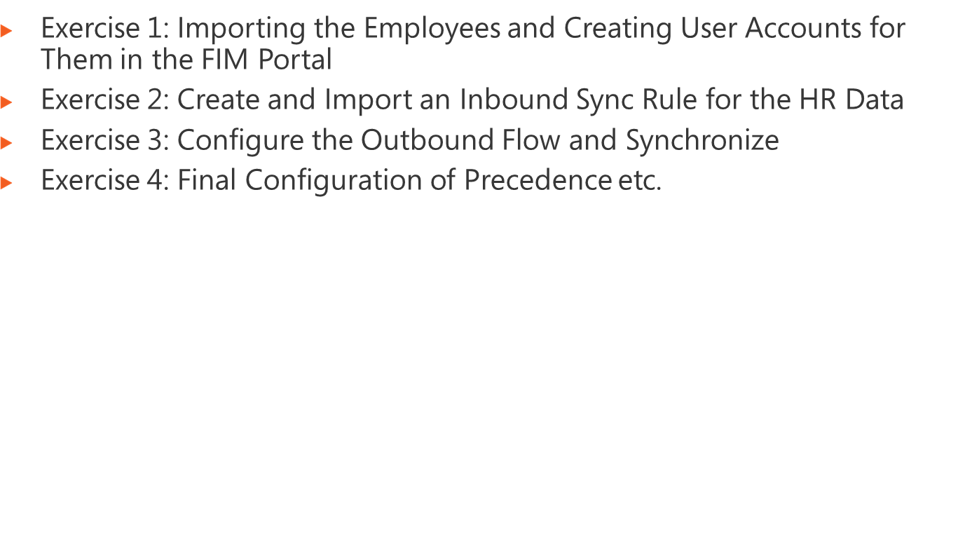
Logon information
Virtual machine | FIM2010RC1
User name | Administrator
Password | Pa$$w0rd
Estimated time: 90 minutes
Notes:
Module x: Title
Course xxxxy
In this lab, students will ….
Exercise 1
In this exercise, students ….
Exercise 2
In this exercise, students ….
Before the students begin the lab, read the scenario associated with each exercise to the class. This will reinforce the broad issue that the students are troubleshooting and will help to facilitate the lab discussion at the end of the module. Remind the students to complete the discussion questions after the last lab exercise.
If this is a KonaH product, use this note:
Note: The lab exercise answer keys are provided on the Course Companion CD. To access the answer key, click the link located at the bottom of the relevant lab exercise page.
If this is a Forte product, use this note:
Note: The lab exercise answer keys are provided on the Course CD.

Slide 17
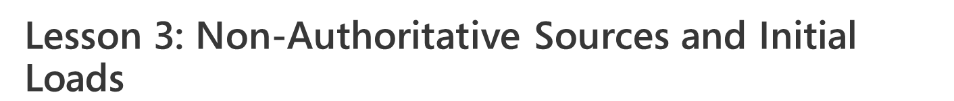
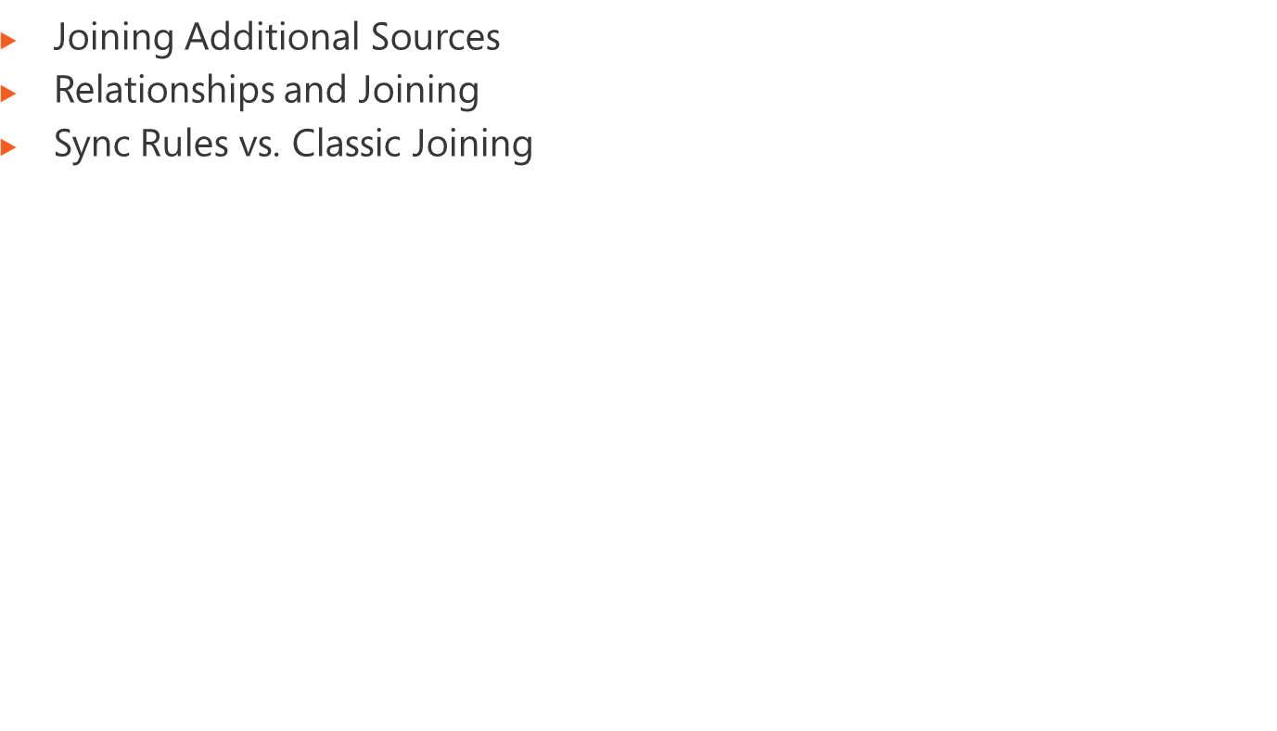
Notes:
Module x: Title
Course xxxxy

Slide 18
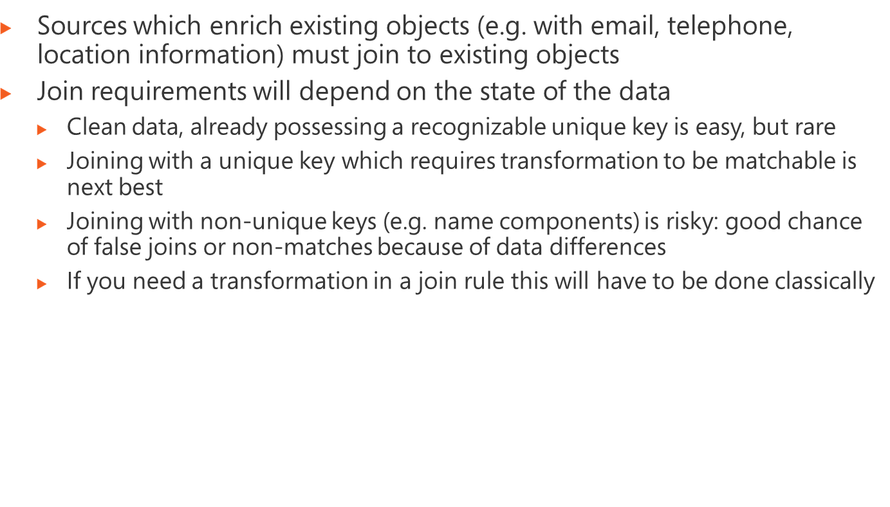
Notes:
Module x: Title
Course xxxxy

Slide 19
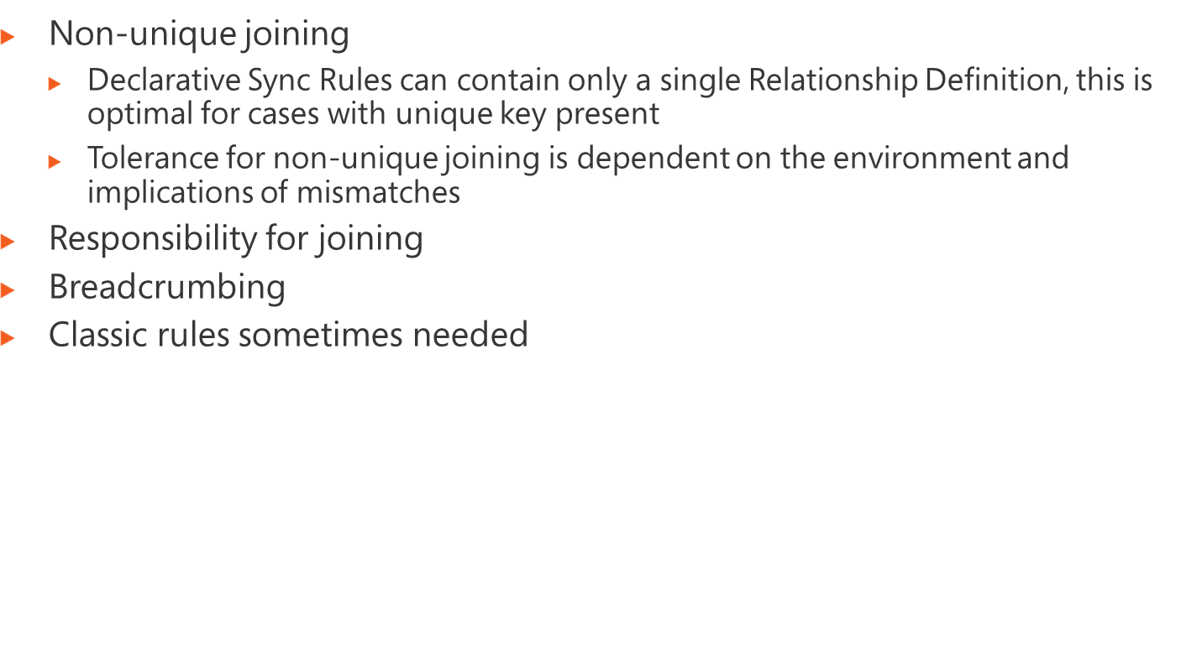
Notes:
Module x: Title
Course xxxxy

Slide 20
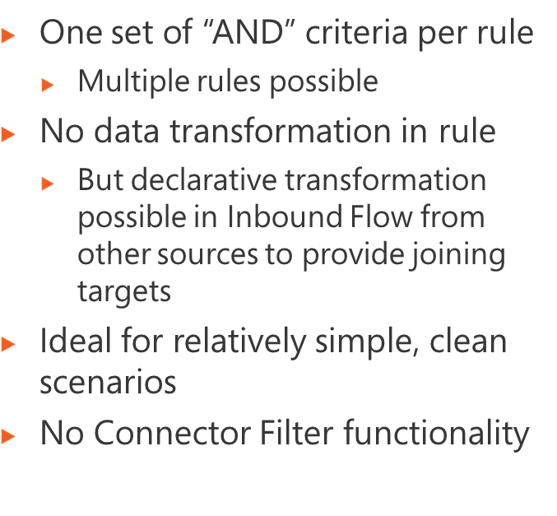
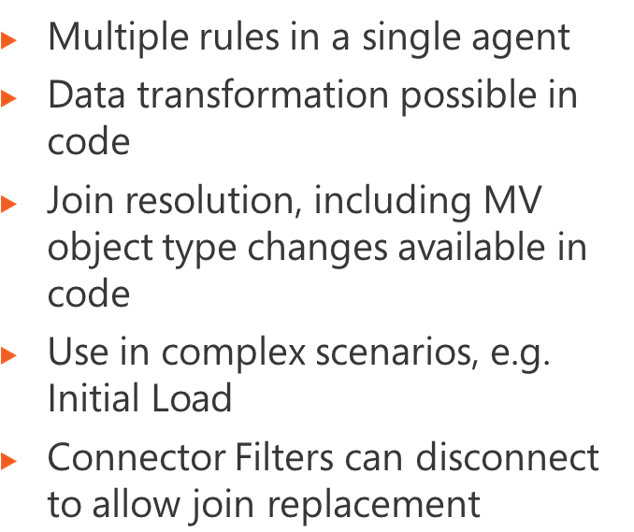
Notes:
Module x: Title
Course xxxxy

Slide 21
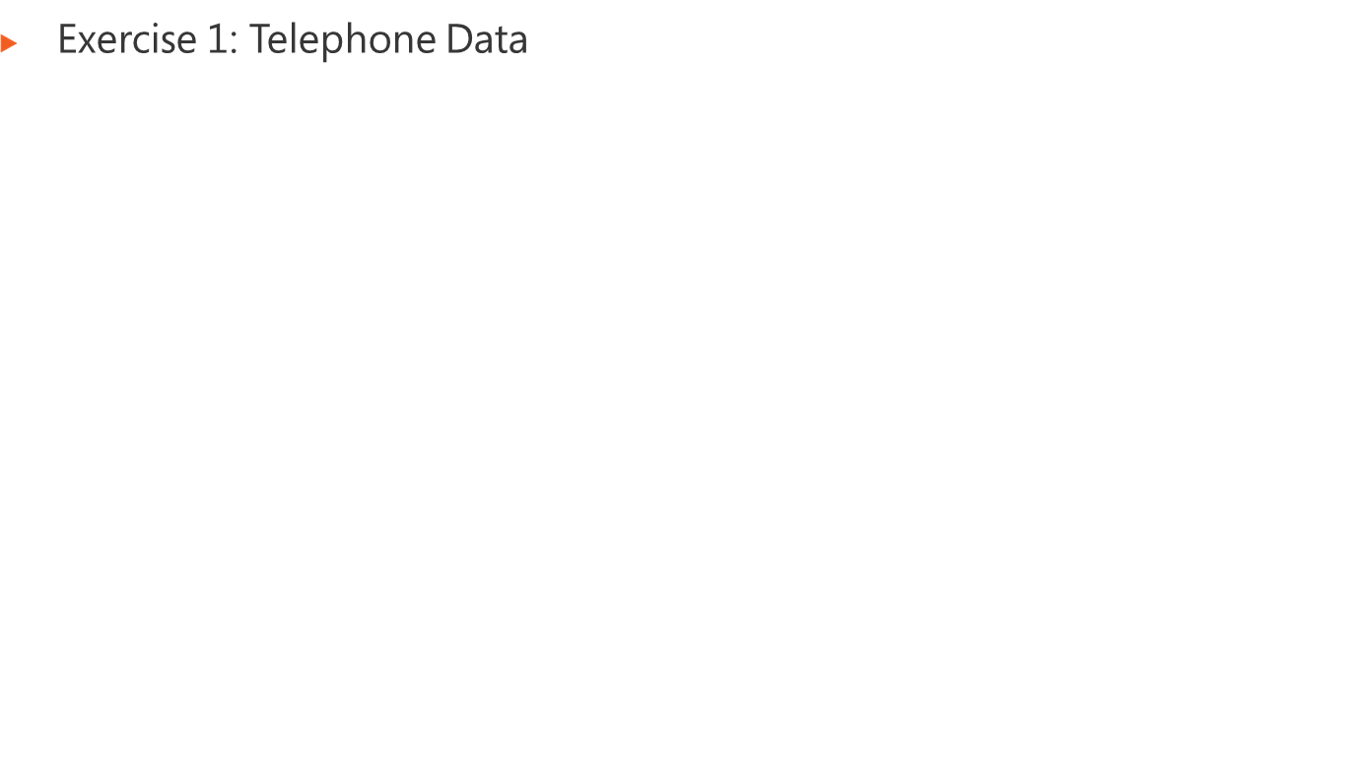
Logon information
Virtual machine | FIM2010RC1
User name | Administrator
Password | Pa$$w0rd
Estimated time: 60 minutes
Notes:
Module x: Title
Course xxxxy
In this lab, students will ….
Exercise 1
In this exercise, students ….
Exercise 2
In this exercise, students ….
Before the students begin the lab, read the scenario associated with each exercise to the class. This will reinforce the broad issue that the students are troubleshooting and will help to facilitate the lab discussion at the end of the module. Remind the students to complete the discussion questions after the last lab exercise.
If this is a KonaH product, use this note:
Note: The lab exercise answer keys are provided on the Course Companion CD. To access the answer key, click the link located at the bottom of the relevant lab exercise page.
If this is a Forte product, use this note:
Note: The lab exercise answer keys are provided on the Course CD.

